Slide 1
Laodicea
Revelation 3:14-22

Slide 2
NOTE: Because of our great appreciation for these pictures, all references are hyperlinked to the original sites so that you can view additional material!

Slide 3
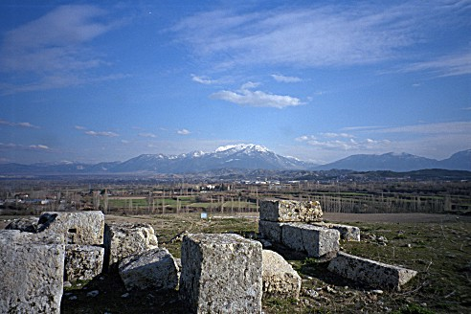
“Laodicea lies at a major crossroads in the valleys
of Asia Minor. The city was situated on a hill overlooking fertile valleys
and majestic mountains. In Roman times, the city was an important center for administration and commerce. Court cases from the region were heard at Laodicea and funds were placed in the city's banks for safekeeping. Although damaged by earthquakes during the reign of Augustus (27 B.C.-A.D.14) and again in A.D. 60, the city kept rebuilding and prospering.”
http://www.luthersem.edu/ckoester/Revelation/main.htm

Slide 4
“Laodicea was a center for the regional textile industry. The sheep that grazed in the nearby valleys produced a black wool that was exceptionally soft. The wool was bought and sold in the city's markets.”
http://www.luthersem.edu/ckoester/Revelation/main.htm

Slide 5
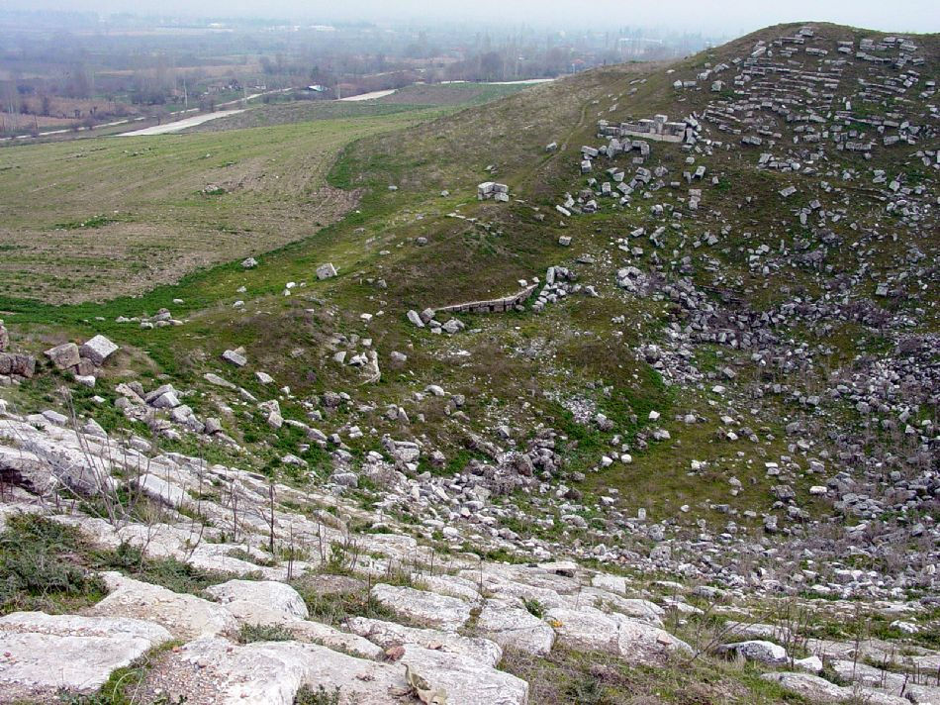
www.holylandphotos.org
Laodicea had its own theater. The city also had a stadium, gymnasium, etc. Gladiatorial games were held in the stadium.

Slide 6
Laodicea had its own theater. The city also had a stadium, gymnasium, etc. Gladiatorial games were held in the stadium.

Slide 7
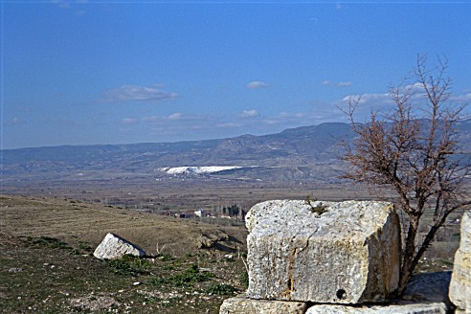
“For I bear him record, that he hath a great zeal for you, and them that are in Laodicea, and them in Hierapolis”
(Col. 4:13)
“Across the
valley from
Laodicea
was the city
of Hieropolis,
which was
located
above the
large white mineral deposits at the center of the photo. Since Hieropolis is much better preserved than Laodicea, a tour of its streets and buildings can help to show something of urban life in this area” (http://www.luthersem.edu/ckoester/Revelation/Laodicea/Hieropolis.htm)
http://www.luthersem.edu/ckoester/Revelation/Laodicea/Hieropolis.htm

Slide 8
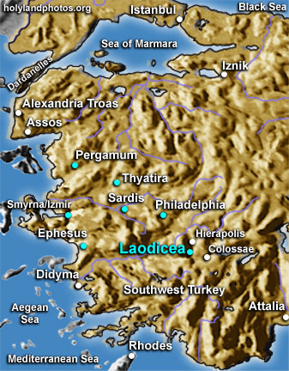
courtesy of www.holylandphotos.org
Laodicea
Hierapolis
Colossae

Slide 9
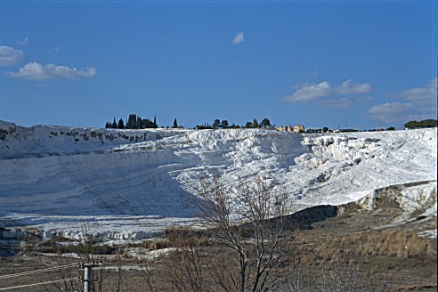
Hierapolis, hot H₂O
Colossae, cold
Laodicea, in the middle/lukewarm H₂O
“Across the
valley from
Laodicea is an
enormous hot
spring. The
white mineral
deposits from
the spring are
visible for
miles across
the valley.
The town of
Hierapolis was built near this spring.”
http://www.luthersem.edu/ckoester/Revelation/main.htm

Slide 10
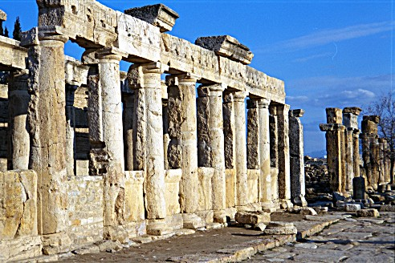
http://www.luthersem.edu/ckoester/Revelation/main.htm
HIERAPOLIS - main street lined by a massive colonnade. Laodicea would have looked comparable!

Slide 11
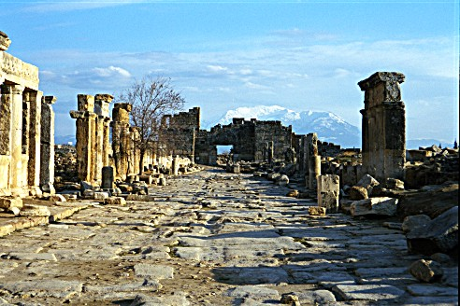
http://www.luthersem.edu/ckoester/Revelation/main.htm
“The pavement on the main street of Hieropolis shows the ruts left by wheeled vehicles that passed this way. The streets of Laodicea would also have been filled with traffic passing along the main routes of commerce in central Asia Minor.”

Slide 12
The Church at Laodicea
commentary
Salutation (3:14)
The Amen
the word “Amen” was transliterated from the Hebrew into the Greek and then into many other languages; it is a near universal word. It means “firm,” “surely,” “so be it,” “agreement”
The Faithful & True Witness
The Beginning of the Creation of God (cf. Col. 1:16)
Greek Letter | a | µ | h | n
Transliteration | a | m | e | n

Slide 13
The Preeminence of Christ as “The Beginning”
The Christ, the Creation, the church
The Christ, the creation, the Church
“And to the angel of the church of the Laodiceans write, `These things says the Amen, the Faithful and True Witness, the Beginning of the creation of God” (Rev. 3:14)
“And He is the head of the body, the church, who is the beginning, the firstborn from the dead, that in all things He may have the preeminence” (Col. 1:18; cf. 1:16, 17)

Slide 14
The Church at Laodicea
commentary
Divine Protest (3:15-17)
knew works. . . works determine if one is cold, hot, lukewarm
hot would be the preferred
why would Jesus wish they would be cold more than lukewarm?
harder to get one to repent who sees himself “in need of nothing” (v. 17)
more hope for one who is cold and aware of his true standing with God
no false sense of security

Slide 15
Protest and the Picture of Christ (v. 16)
commentary
a picture of a sick man
overcome with nausea
about to vomit
a picture of disgust for sin
Similar: “And the Lord was sorry that he had made man on the earth, and He was grieved in His heart” (Gen. 6:6)

Slide 16
Do We Have The Spiritual Vision To See Ourselves As Christ Sees Us?
commentary
the lukewarm Christian:
doesn’t see himself as God does
is blind to his indifference
cannot perceive his error
is too lazy to test himself (2 Cor. 13:5)
doesn’t know that he is the reason others excuse themselves for sin, for not coming to worship, for not obeying, for being worldly, etc.

Slide 17
The Church at Laodicea
commentary
probably wealthier than the other churches and over confident
Jesus looking down from heaven saw them as:
wretched (afflicted)
miserable (to be pitied)
poor (reduced to begging, destitute of wealth, influence, honor)
blind (mentally)
naked (ill clad, not covered, like grain stripped from a plant)

Slide 18
The Church at Laodicea
commentary
Divine Prescription (3:18, 19)
buy from Christ gold refined in fire (“buy” cf. Is. 55:1; Prov. 23:23; Matt. 13:44)
to acquire gold from heaven, one must be “poor” in spirit (Matt. 5:3; Jas. 2:5; 1 Tim. 6:18; Rev. 2:9)
white garments to be clothed (cf. 19:8)
anoint eyes to see

Slide 19
The Church at Laodicea
commentary
Be zealous and repent (3:19)
“to burn
with zeal”
(#2206)
“to change
one’s mind
for better. . .”
(#3340)

Slide 20
The Love/Chasten Connection (3:19)
commentary
opinions of men say chastisement/discipline goes against and is contrary to “love.”
Jesus bound the two together
Hebrews 12:5-10
“Do not correct a scoffer, lest he hate you, rebuke a wise man and he will love you” (Prov. 9:8)

Slide 21
The Church at Laodicea
commentary
Divine Invitation (3:20-22)
Jesus at the door
not kicking, not running at it
simply knocking
outside—outside of fellowship
waiting and wanting someone to open (Jn. 14:21-24)
where were the Laodiceans?
were they listening…avoiding…ignoring?
God requires them to do something: hear & open
a picture of urgency (Lk. 12:35, 36)

Slide 22
The Church at Laodicea
commentary
Divine Invitation (3:20-22)
a promise to rule with Christ
more positive proof that Christ now reigns (Eph. 1:20-22)
premillennialists need to stay out of Revelation!
Father’s throne in that He gave it to Jesus
we shall rule with Him (2 Tim. 2:11, 12)

